Slide 1
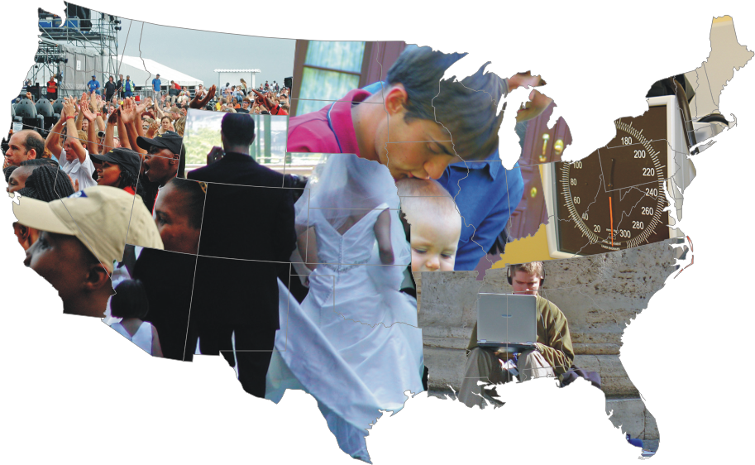
Predicting Diseases of Despair
Lauren Gaydosh
Center for Medicine, Health, and Society
Public Policy Studies
Notes:
1

Slide 2
Overview
Motivation for this project
Objectives
Data and Add Health introduction

Slide 3
Motivation

Slide 4
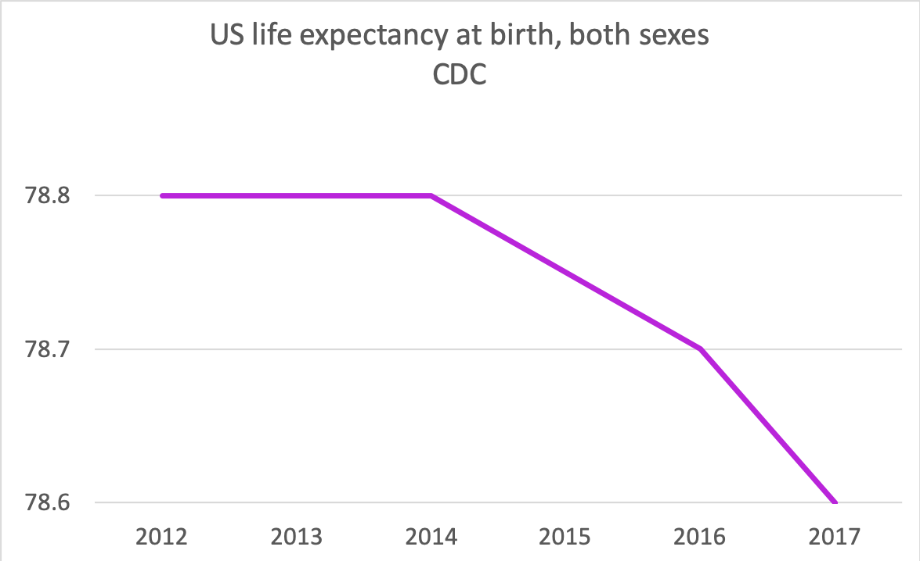


Slide 6
objectives

Slide 7
Can we use supervised machine learning to predict the behaviors of despair?
Compare to traditional statistical methods
Are despair measures relevant in predicting behaviors?
Are different behaviors predicted similarly well?
Do different behaviors have similar important/relevant predictors?
Is despair related to the behaviors that predict associated causes of death?

Slide 8
Definitions
Deaths of despair - suicide, drug overdose, alcohol-related liver disease
Behaviors/diseases of despair – the behaviors and conditions that would predict “despair” causes of death:
Suicidal ideation
Drug use, abuse, misuse
Alcohol use, abuse, problematic drinking
Despair – emotional and cognitive measures of hopelessness

Slide 9
Data and Add Health Introduction

Slide 10
Key Features of Add Health
Nationally representative study that explores the causes of health and health-related behaviors of adolescents and their outcomes in young adulthood.
Multi-survey, multi-wave inter-disciplinary design.
Direct measurement of the social contexts of adolescent life and their effects on health and health behavior.
Unprecedented racial and ethnic diversity and genetically informed sibling samples.

Slide 11
Sampling Structure
School Sampling Frame = QED
HS
HS
HS
HS
HS
H
Feeder
Feeder
Feeder
Feeder
Feeder
Sampling Frame of Adolescents and Parents N = 100,000+ (100 to 4,000 per pair of schools)
Ethnic Samples
High Educ
Black
Saturation
Samples
from 16 Schools
Disabled Sample
Puerto Rican
Main Sample 200/Community
Chinese
Genetic
Samples
Cuban
Identical Twins
Fraternal Twins
Full Sibs
Half Sibs
Unrelated Pairs
in Same HH

Slide 12
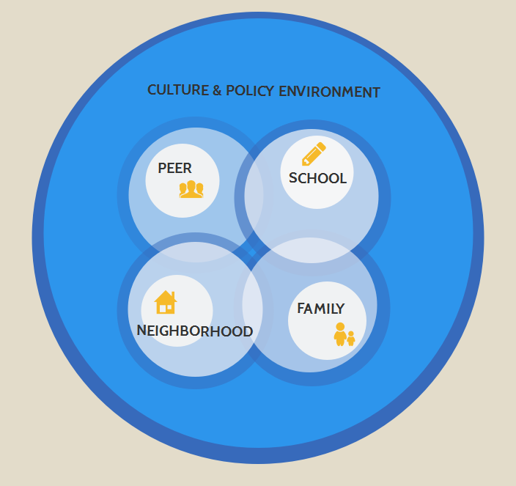

Add Health Contextual model

Slide 13

Social, Behavioral, and Biological Linkages Across the Life Course
In-School
Administration
Survey
Administration
Wave I
1994-1995
(79%)
School
Admin
144
Adolescents
in grades 7-12
20,745
Parent
17,670
Students
90,118
Wave II
1996
(88.6%)
School
Admin
128
Adolescents
in grades 8-12
14,738
Wave III
2001-2002
(77.4%)
Partners
1,507
Young Adults
Aged 18-26
15,197
Wave IV
2008
(80.3%)
IIV Study
~100
Adults
Aged 24-32
15,701
Wave V
2016-18
IIV Study
~100
Adults
Aged 32-42
Target: 12,000
Parent
3,000
Notes:
13

Slide 14
Questionnaire Content Across Waves
Waves I, II
Demographic
Family, siblings, friends
Education, work
Physical and mental health
Daily activities and sleep
Relationships
Sexual, & fertility histories
Substance use
Delinquency and violence
Attitudes, religion
Economics, expectations
Psychological, personality
Wave III
Demographic
Family, siblings, friends
Education, work, military
Physical and mental health
Daily activities and sleep
Relationships
Sexual, & fertility histories
Substance use
Involvmt w/criminal justice sys
Attitudes, religion
Economics, expectations
Psychological, personality
Children and parenting
Civic participation
Gambling
Mentoring
Wave IV
Demographic
Family, siblings, friends
Educ, work, military (records)
Physical and mental health
Daily activities and sleep
Relationships
Sexual, & fertility histories
Substance use and abuse
Involvmt w/criminal justice sys
Work attitudes and chars, relig
Economics, expectations
Big 5 Personality, stressors
Children and parenting
Civic participation
Cognitive function
Psychosocial factors
Wave V
Demographic
Family, siblings, friends
Educ, work, military
Physical and mental health
Daily activities and sleep
Relationships
Sexual, & fertility histories
Substance use and abuse
Involvmt w/criminal justice sys
Work attitudes and chars, relig
Economics, expectations
Personality, Stressors
Children and parenting
Civic participation
Cognitive function
Psychosocial factors
Retrospective childhood health & SES
Notes:
14

Slide 15
Physical and Social Contextual Data Across Waves
Adolescence | Transition to Adulthood | Young Adulthood | Adulthood
Wave I-II (Ages 12-20) | Wave III (Ages 18-26) | Wave IV (Ages 24-32) | Wave V (Ages 32-42)
School | College | College | Work
Peer | Peer
Family
Romantic Relationships
Neighborhood
Community
Notes:
15

Slide 16
Biological Data Across Waves
Adolescence | Transition to Adulthood | Young Adulthood | Adulthood
Wave I-II (Ages 12-20) | Wave III (Ages 18-26) | Wave IV (Ages 24-32) | Wave V (Ages 32-42)
Embedded genetic sample of ~3,000 pairs
Physical development
Height, weight | Height, weight | Height, weight, waist | Height, weight, waist
 | STI tests (urine) | Metabolic | Metabolic
 | HIV test (saliva) | Immune function | Immune function
 | Genetic (buccal cell DNA) | Inflammation | Inflammation
 |  | Cardiovascular | Cardiovascular
 |  | Genetic (buccal cell DNA) | Genetic (whole blood)
 |  | Medications | Medications
 |  |  | Renal
Notes:
16

Slide 17
Dependent variables to be predicted – despair behaviors
Suicidal ideation at Wave IV/V
Thoughts of suicide in the last 12 months
Alcohol use at Wave IV/V
Days drank alcohol in last 12 months
Drinks each time in last 12 months
Days drank alcohol in last 3 months
Drinks each time in last 3 months
Occasions of more than 4/5 drinks in a row in last 12 months
Marijuana use at Wave IV/V
Times used in last 30 days
Illegal drug use at Wave IV/V
Lifetime (IV) and last 30 day (V) use of cocaine, crystal meth, heroin, other illegal drugs (separately)
Prescription drug abuse at Wave IV/V
Lifetime (IV) and last 30 day (V) use of sedatives, tranquilizers, stimulants, painkillers (separately)
DSM4 diagnosis at Wave IV
Lifetime diagnosis of alcohol abuse or dependence
Lifetime diagnosis of cannabis abuse or dependence
Lifetime diagnosis of other drug abuse or dependence

Slide 18
How do you explore the data?

Slide 19

Interactive tool, developed in 2015 by the Add Health Team
Developed in response to feedback that pdf codebooks were difficult to navigate and information on data collected across waves was nearly impossible to find
Browse by topic or search by variable name, keyword, or phrase to discover the rich volume of data collected by Add Health

Slide 20
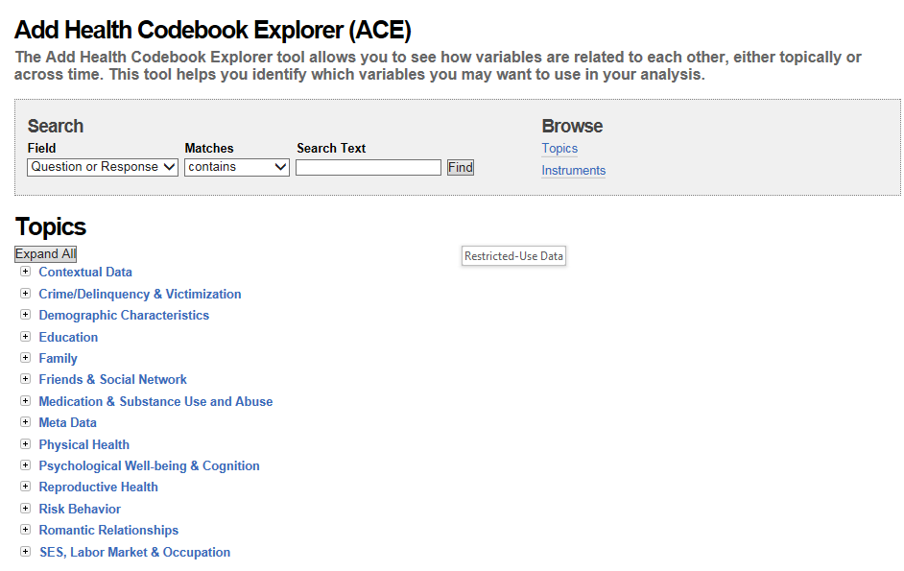
BROWSE BY TOPICS

Slide 21
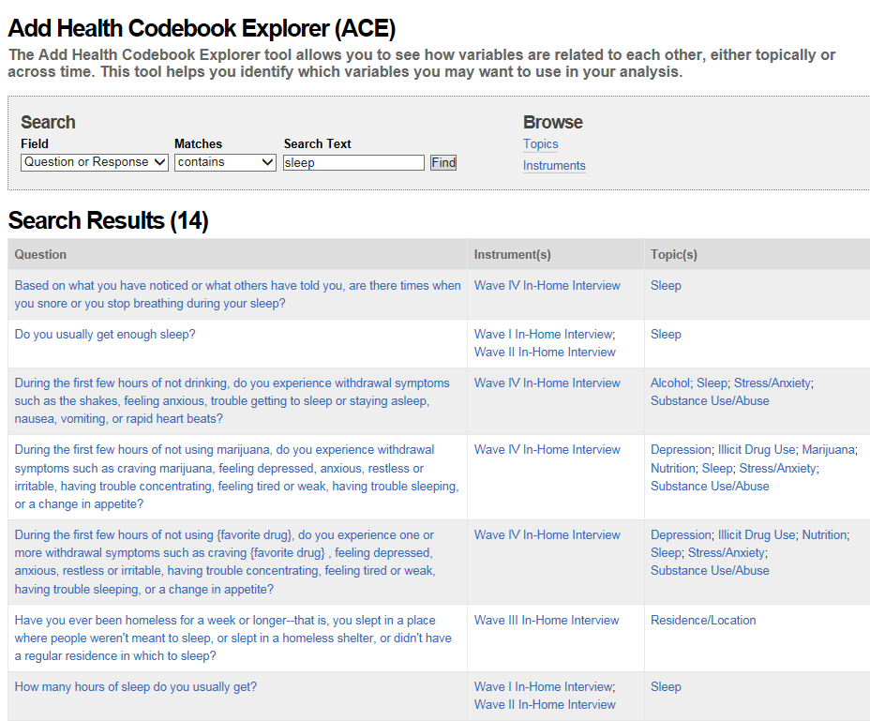
BROWSE BY KEYWORDS

